Slide 1

Modeling soil moisture with closure phase bias
Yujie Zheng^{1,2} and Heresh Fattahi³
California Institute of Technology, USA
University of Texas at Dallas, USA
(3) Jet Propulsion Laboratory, California Institute of Technology, USA
FRINGE 2023 University of Leeds, UK | 11 - 15 September 2023.

Slide 2
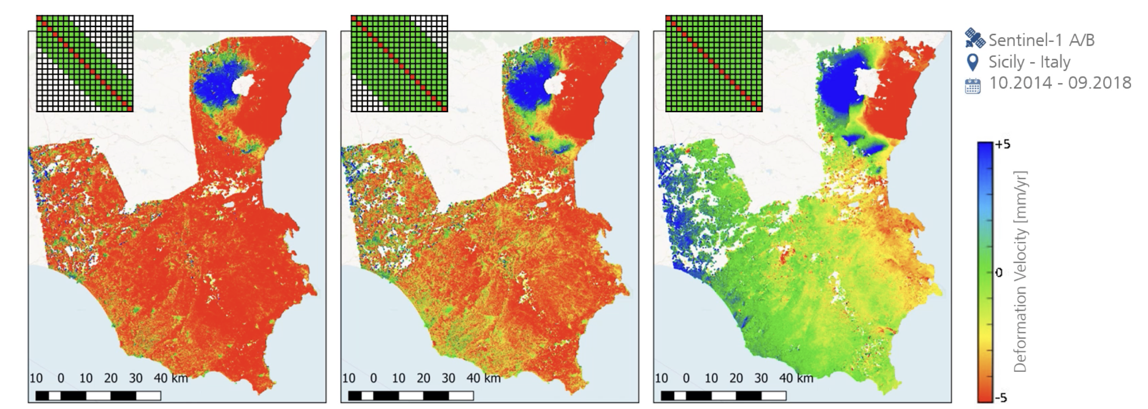
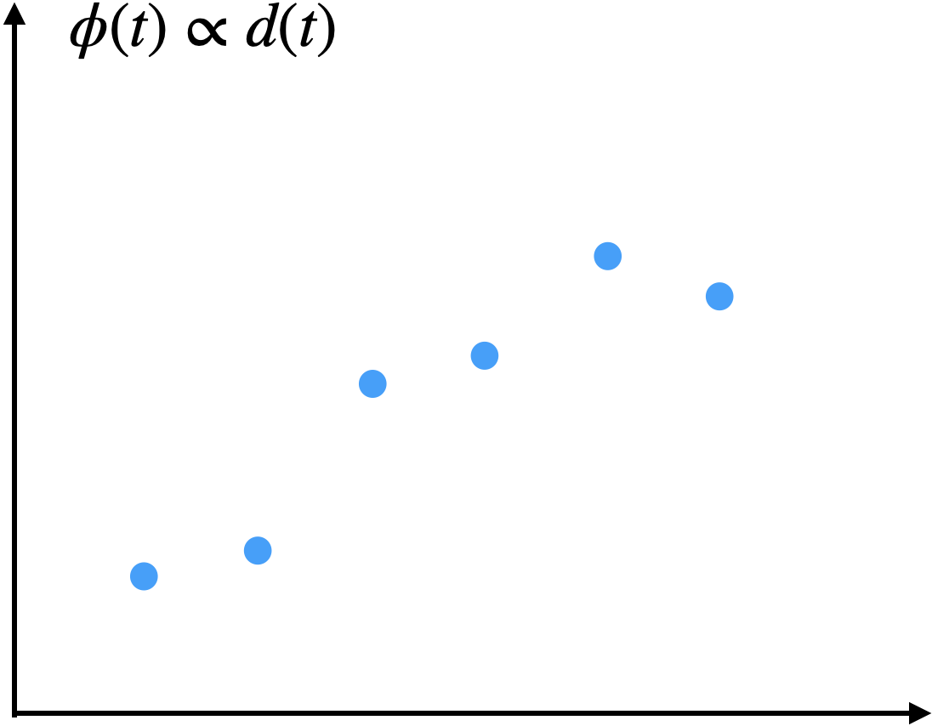
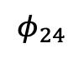
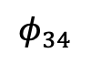
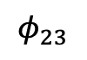
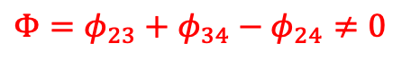
Non-zero closure phase
Short Temporal Bias in time-series
$$Φ=φ_{23}+φ_{34}−φ_{24}≠0$$
$$φ_{34}$$
$$φ_{23}$$
Ansari et.al. (2020)
$$φ_{24}$$
Both phenomena are indicators of processes that induce complex changes of the interferometric measurements. (Zheng et al., 2022)
Bias correction methods :
Falabella and Pepe, 2022; Maghsoudi et al., 2022; Zheng et al., 2022
SAR acquisitions
Notes:
What is non-zero closure phase? Non-closing triplet and by extension any non-closing loop
Why does it cause bias in time-series? – these equations are how we build redundancy in time-series analsysis.

Slide 3
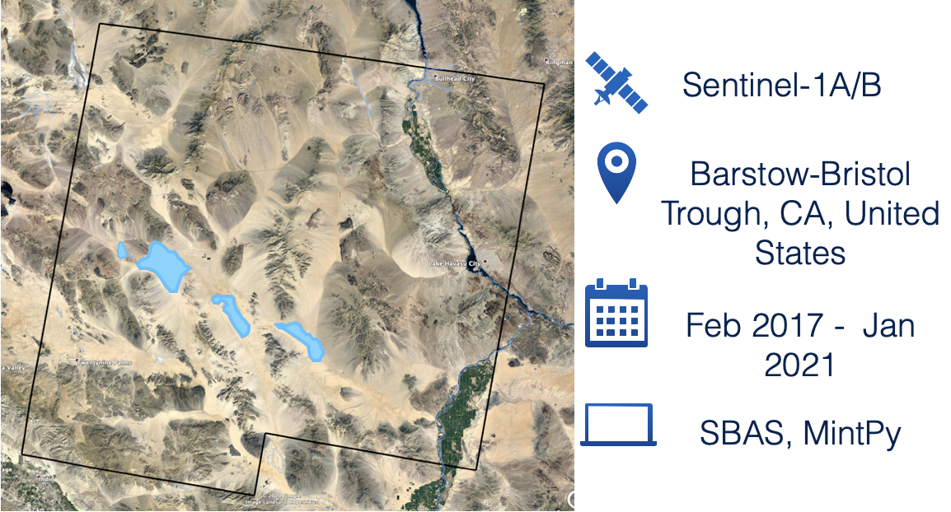
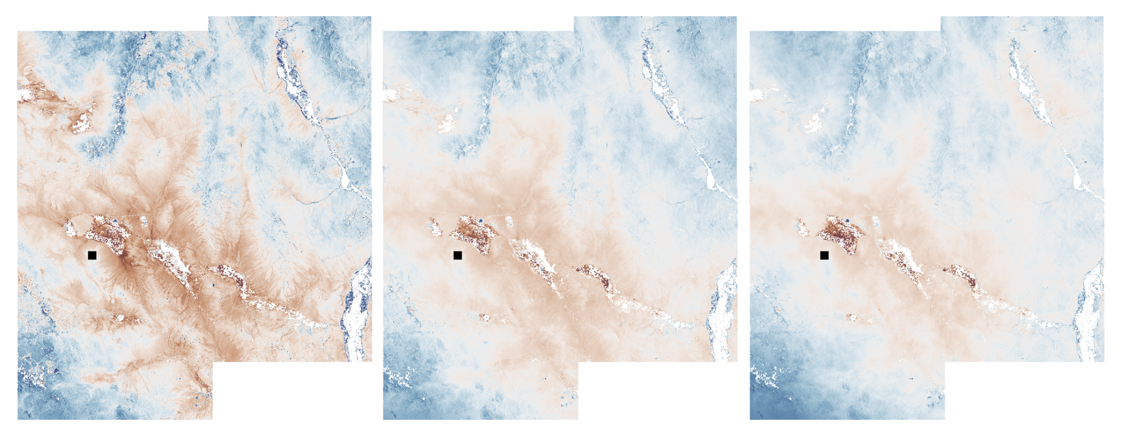
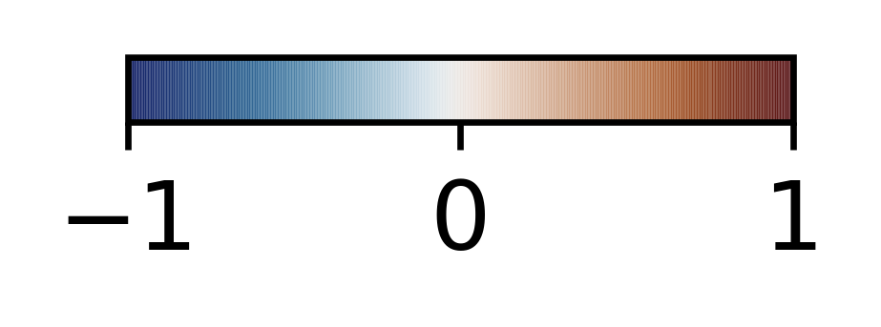
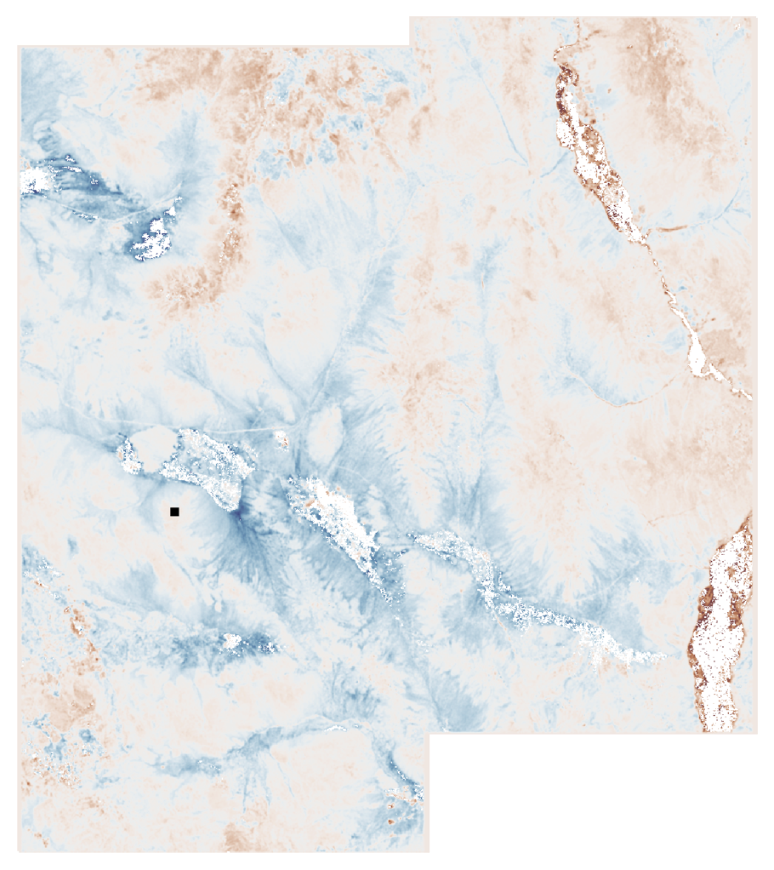
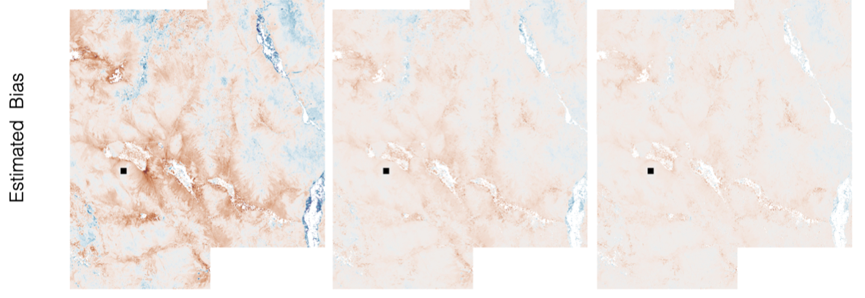
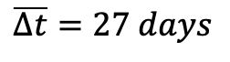
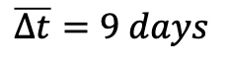
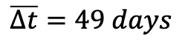
Bias Correction with Sequential Closure Phase
$$\overline{Δt}=9 days$$
$$\overline{Δt}=27 days$$
$$\overline{Δt}=49 days$$
Cumulative Sequential Closure Phase
cm/year
Zheng et al., 2022
Correction code available in MintPy
Notes:
We show that sequential closure phases can be used to identify, reconstruct, and ultimately correct the bias time series from the DSI time series.

Slide 4
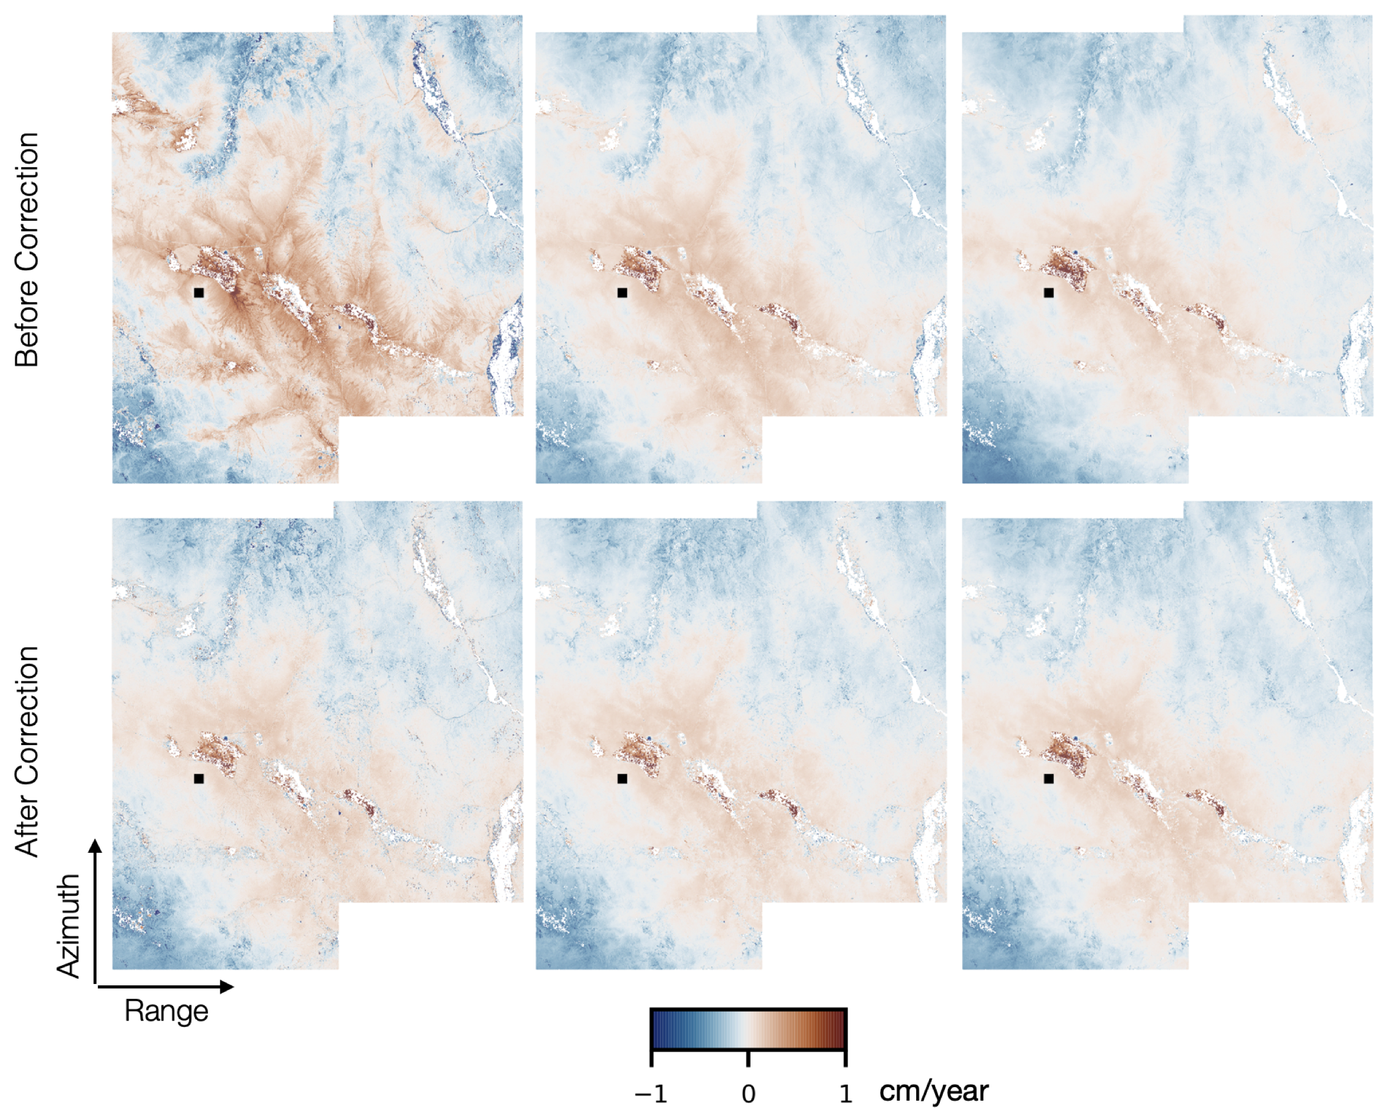
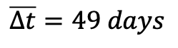
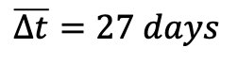
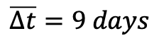
Bias Correction with Sequential Closure Phase
$$\overline{Δt}=9 days$$
$$\overline{Δt}=27 days$$
$$\overline{Δt}=49 days$$
Cumulative Sequential Closure Phase
Zheng et al., 2022
Correction code available in MintPy

Slide 5
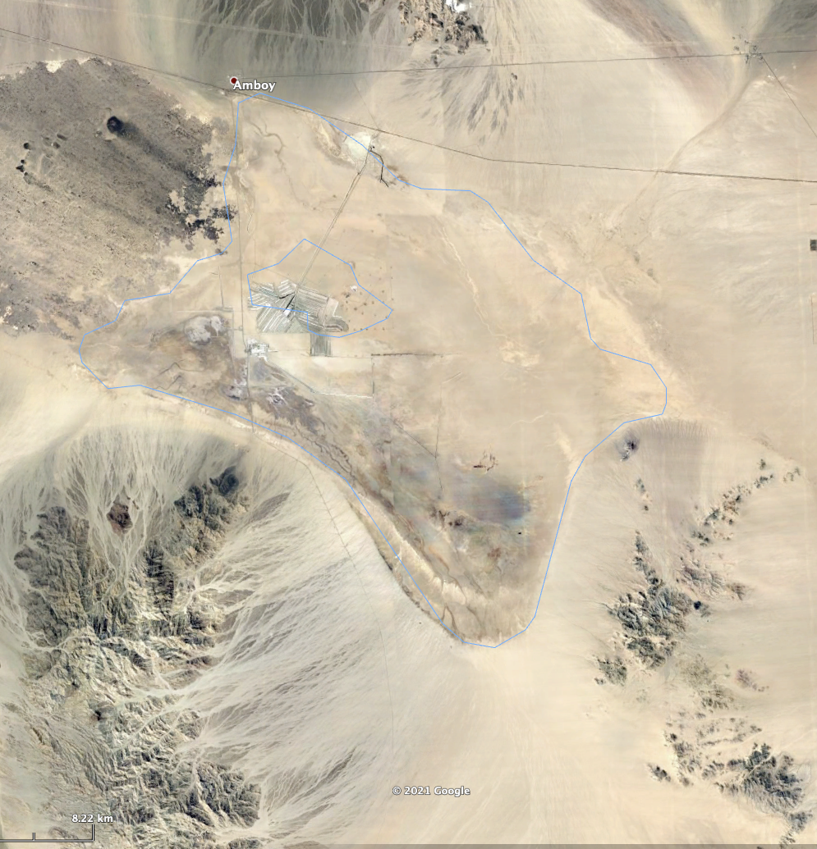
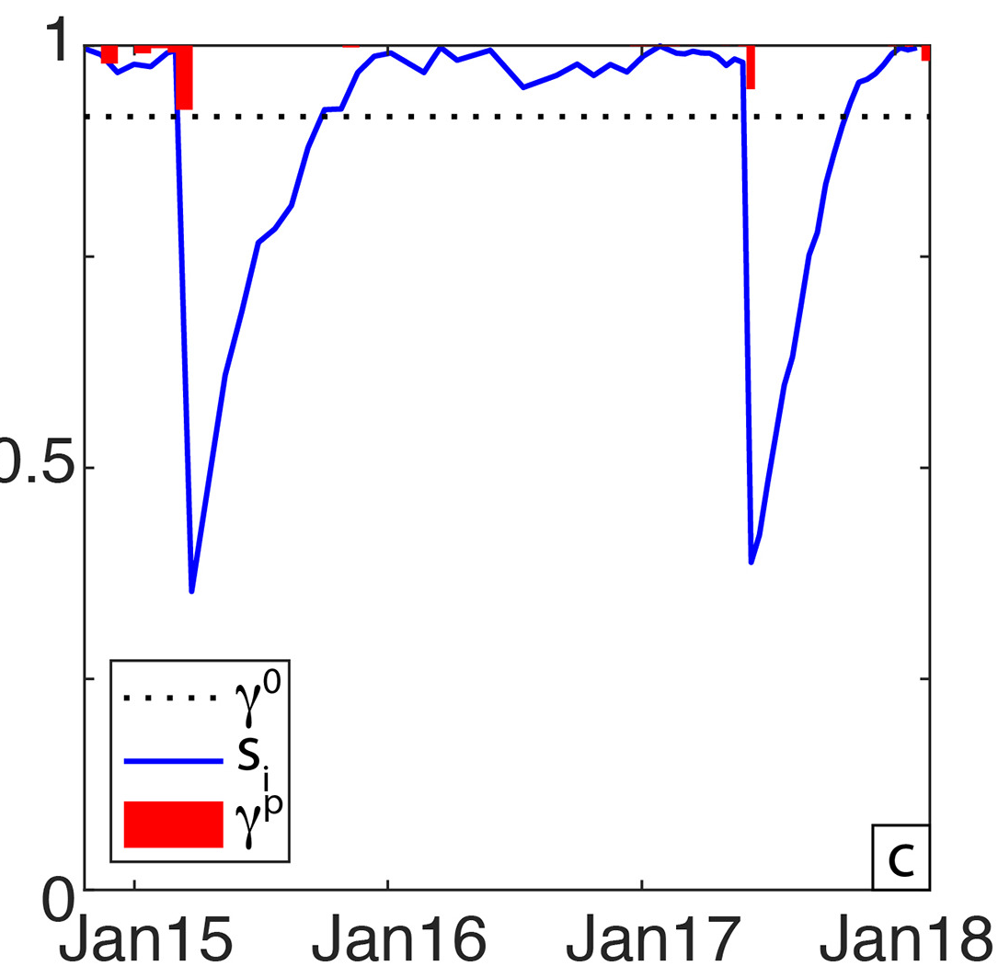
Closure Phase Bias as SIGNAL
Bristol Dry lake, CA
Closure phase bias, cm
Precipitation, cm
Cumulative Precipitation, cm
Jordan et al., (2020
Notes:
Remedy.

Slide 6
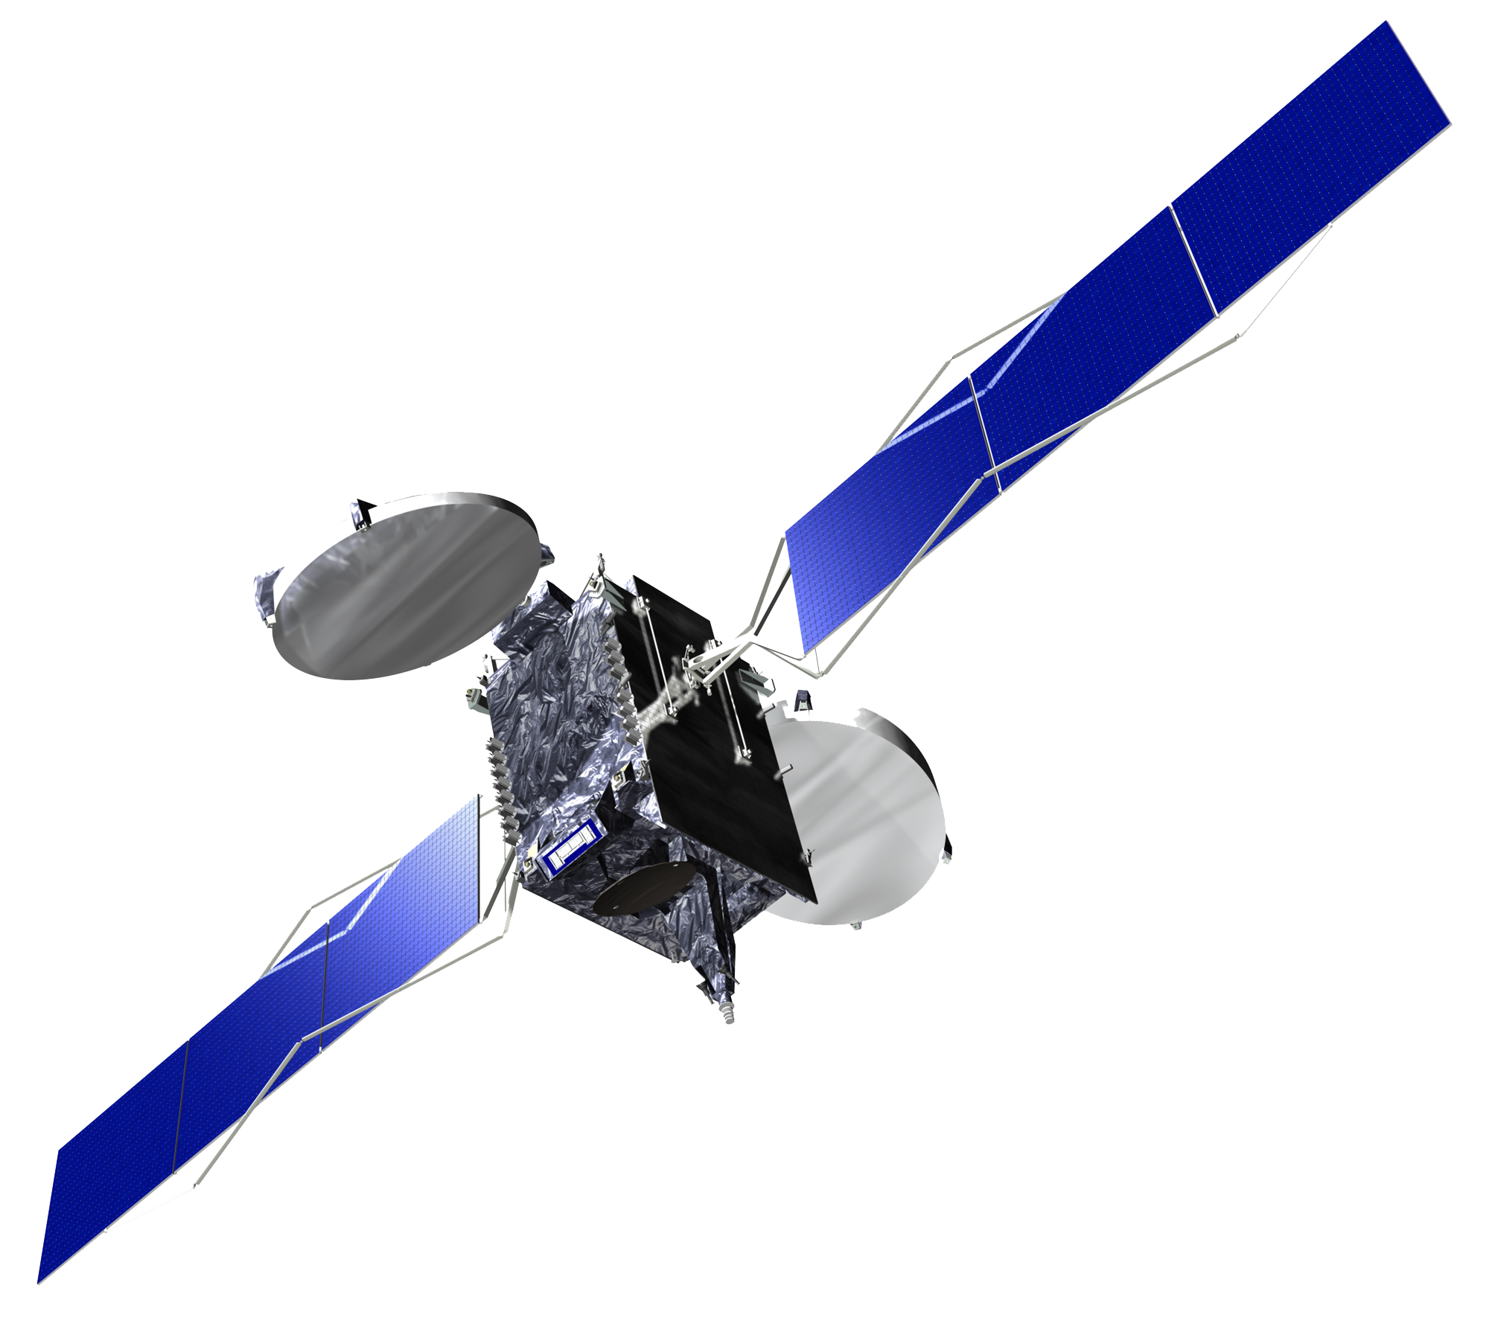


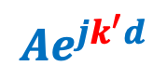

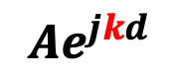
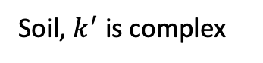
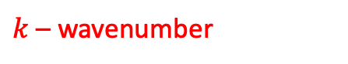
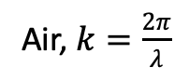
A discrete interferometric model for soil moisture
$k$ – wavenumber
Air, $k=\frac{2π}{λ}$
Easy to implement for numerical simulation.
Easier to adapt to more realistic scenarios.
Can start from single-look radar return.
Soil, $k^{′}$ is complex
$${Ae}^{jkd}$$
$${Ae}^{jk^{′}d}$$
Analytical model for soil moisture
e.g., De Zan et al., 2014; Michaelides, 2020
Air, $k=\frac{2π}{λ}$
Discretized model for soil moisture
Soil, $k^{′}$ is complex

Slide 7
From soil moisture to closure phase bias – Numerical Simulation
Case I – Arid environment
…
20 by 20 Single-Look-Complex
time
Case II – Wet environment
…
20 by 20 Single-Look-Complex
time

Slide 8
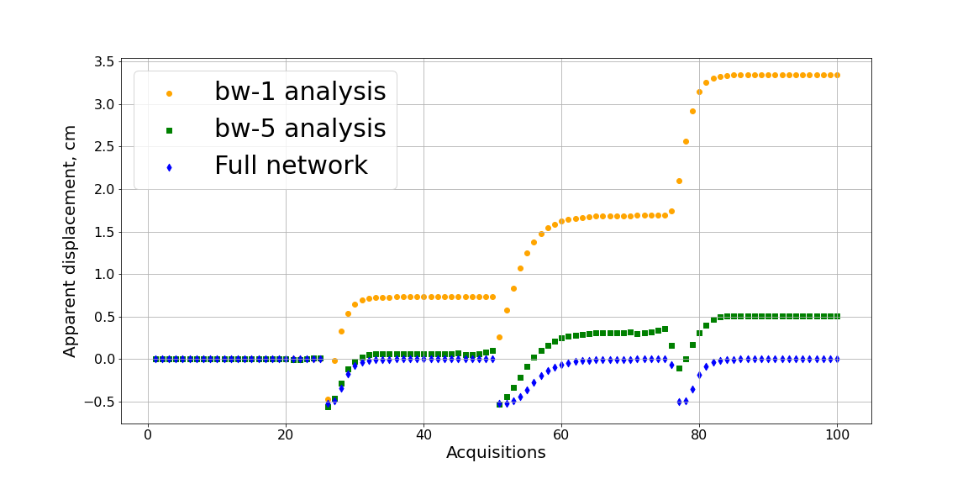
From soil moisture to closure phase bias – Numerical Simulation
Rain event 3
Case I – Arid environment
Rain event 1
Rain event 2
Soil moisture
Example of arid environment soil moisture in one year (in-situ)
Step 1: Simulate 100 SAR acquisitions, each acquisition contains 400 pixels
Step 2: Form interferograms and multi-look by 400
Step 3: Time-series analysis of different bandwidth
Time-series, cm
Notes:
This is to show we have a forward model
Simulation results
Interpretation – why cumulative effects

Slide 9
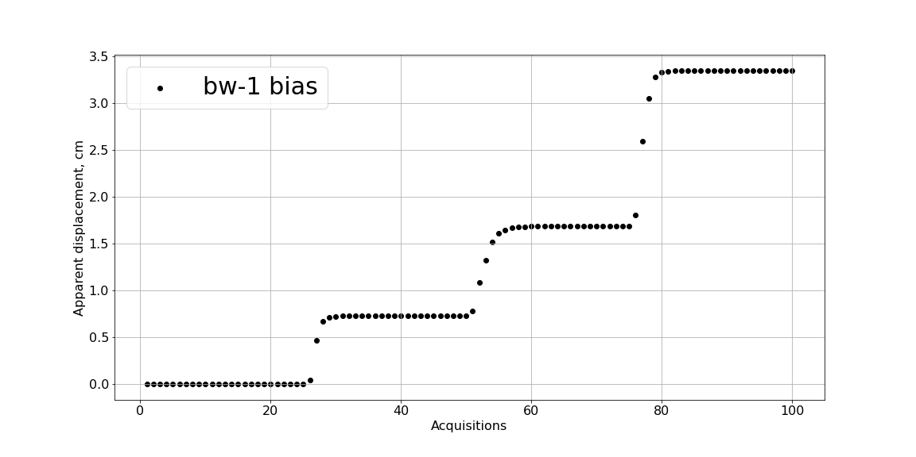
From soil moisture to closure phase bias – Numerical Simulation
Rain event 3
Case I – Arid environment
Rain event 1
Rain event 2
Soil moisture
Key findings:
“Uplift” in closure phase bias corresponds to soil drying after rainfall.
Uplift magnitude depends on soil moisture decay rate and variation
Slower decay and greater variation result in larger uplift
Closure phase bias, cm
Notes:
This is to show we have a forward model
Simulation results
Interpretation – why cumulative effects

Slide 10
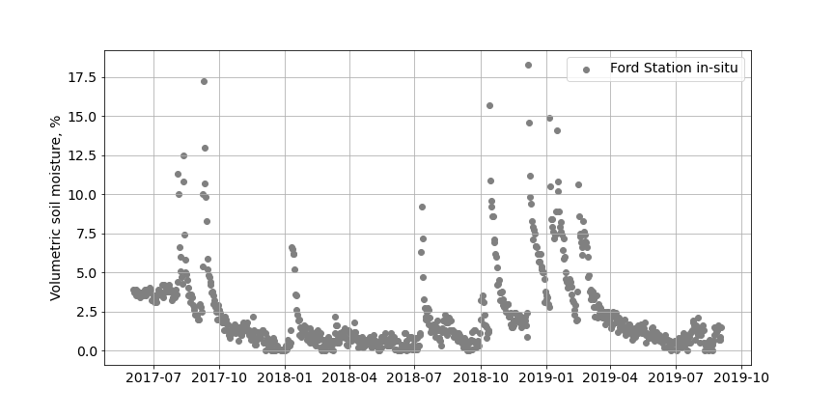
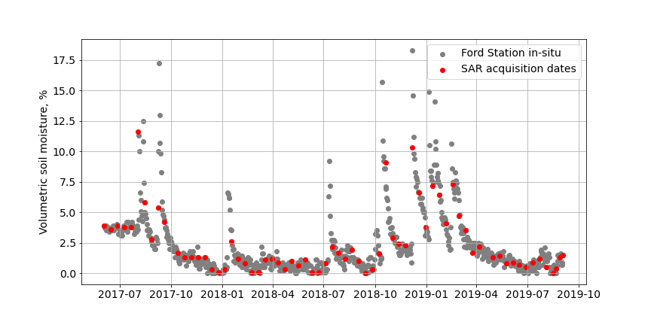
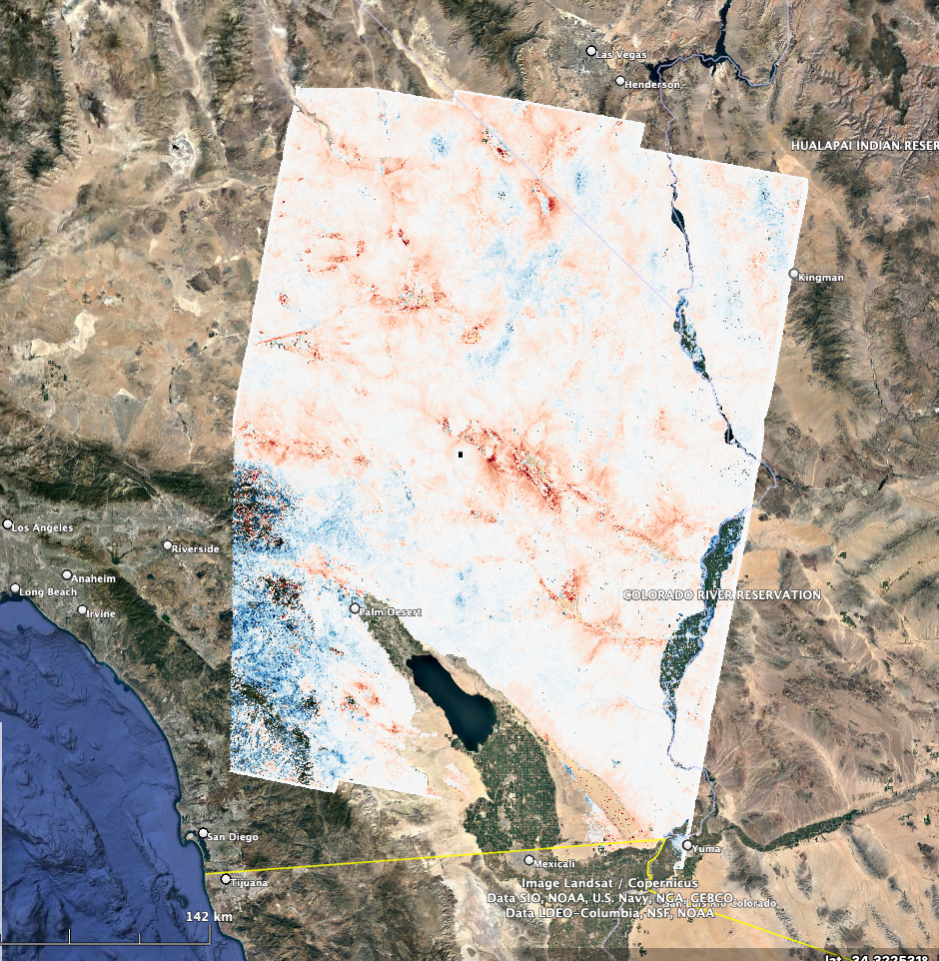
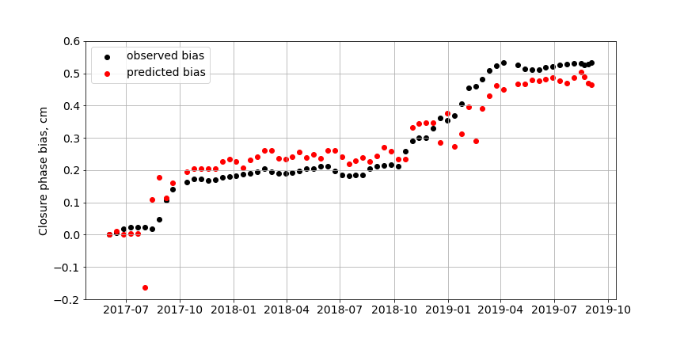
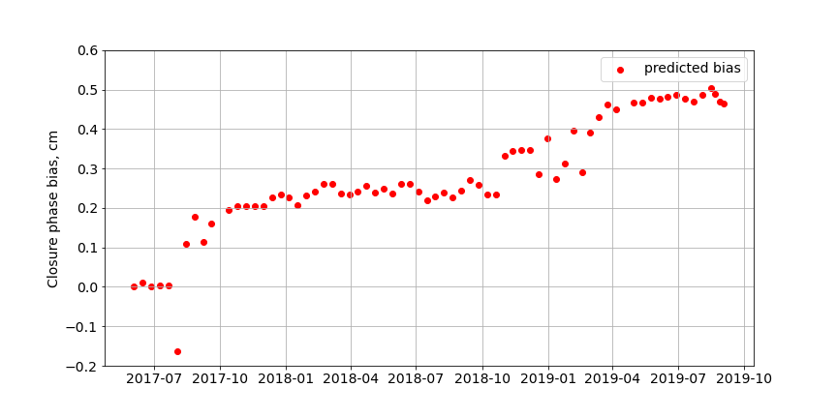
Forward model validated with in-situ measurements
Case I – Arid environment
300 km
Moisture Volume
FORD STATION
bw-1 bias time-series, cm
Closure phase bias, cm/year
Pixel size : 300 meter

Slide 11
From closure phase bias to soil moisture: inversion scheme
bias
Soil moisture

Slide 12
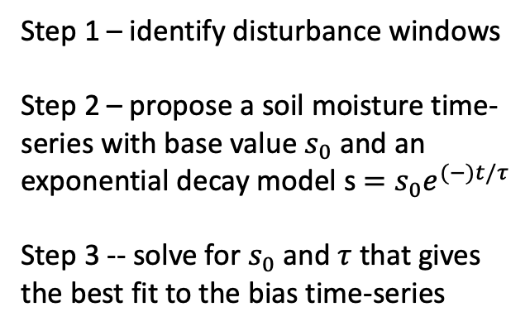
From closure phase bias to soil moisture: inversion scheme
bias
Step 1 – identify disturbance windows
Step 2 – propose a soil moisture time-series with base value $s_{0}$ and an exponential decay model s$=s_{0}e^{(−)t/τ}$
Step 3 -- solve for $s_{0}$ and $τ$that gives the best fit to the bias time-series
Soil moisture

Slide 13
From closure phase bias to soil moisture: initial results
Step 1 – identify disturbance windows
Closure phase bias
Six disturbance events detected
Closure phase bias gradient

Slide 14
From closure phase bias to soil moisture: initial results
Step 2 & 3 – find the best fit soil moisture time-series

Slide 15
From closure phase bias to soil moisture: bias gradient as a proxy
Bias gradient
In-situ soil moisture measurements

Slide 16
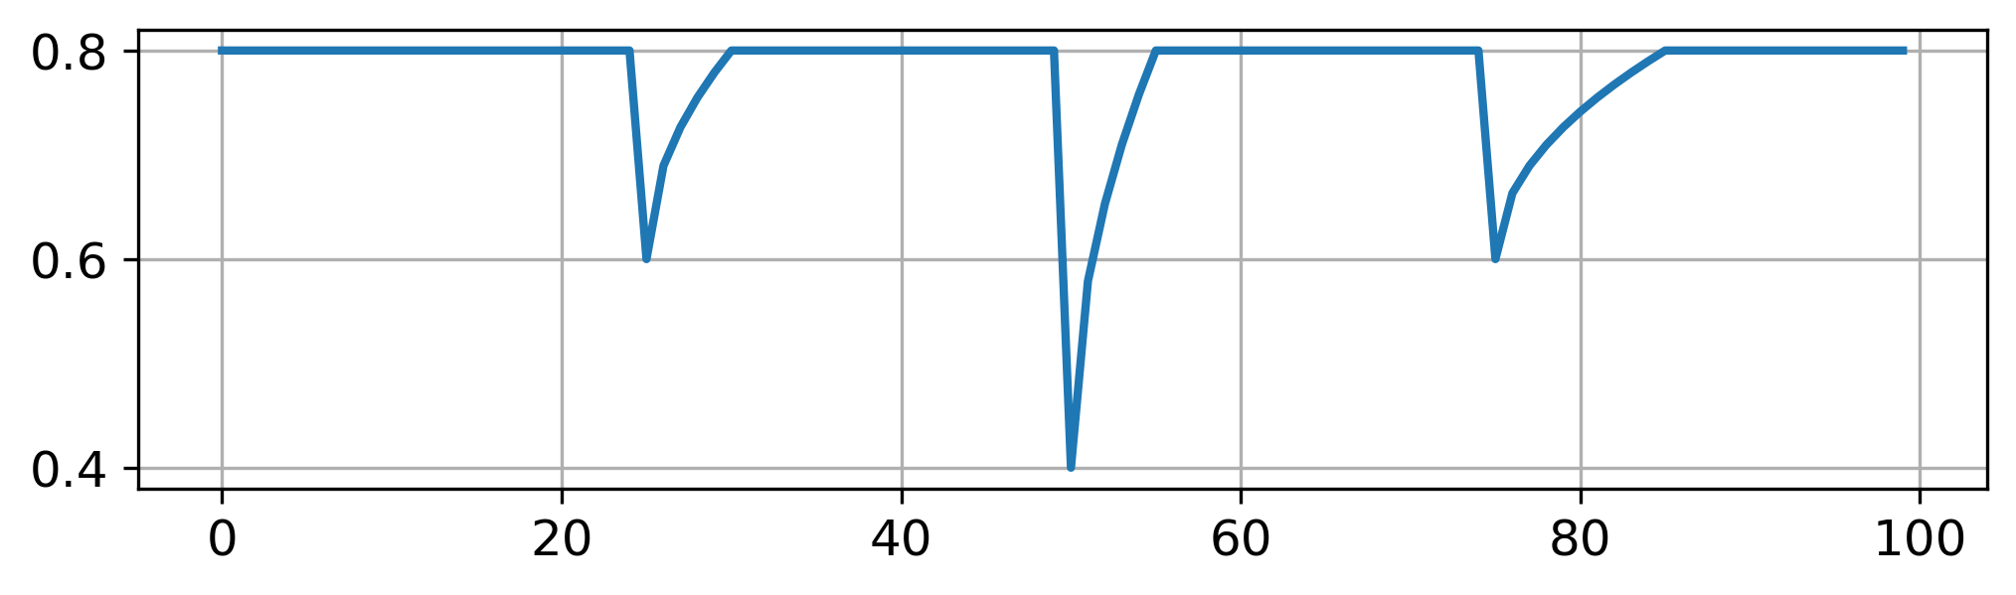
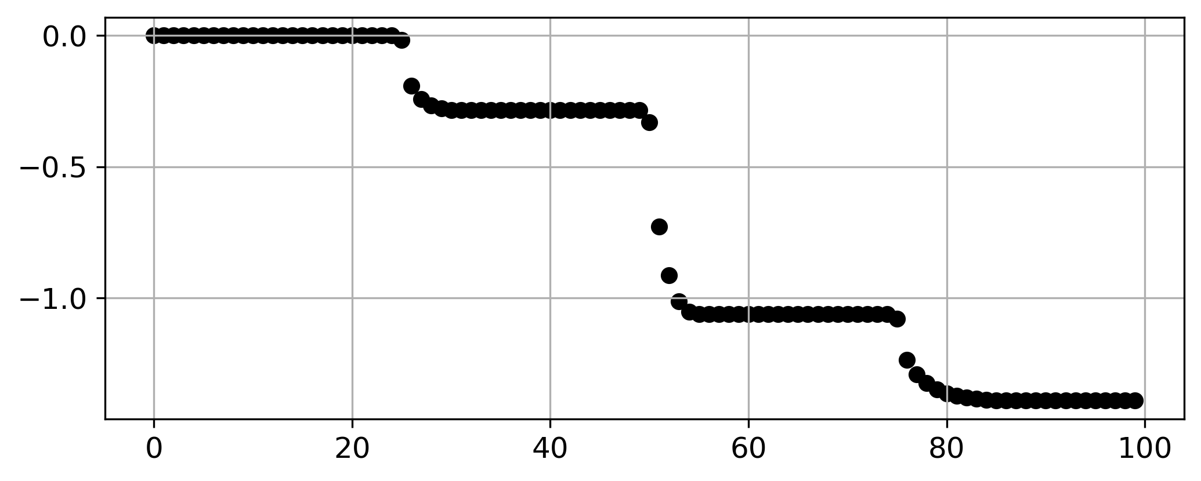
From soil moisture to closure phase bias – Numerical Simulation
Case II – Wet environment
Example of wet environment soil moisture in one year (in-situ)
Soil moisture
Key findings:
“Subsidence” in closure phase bias corresponds to soil moisture increase after irrigation.
subsidence magnitude depends on soil moisture increase rate and variation
Slower increase and greater variation result in larger subsidence
Closure phase bias, cm
acquisitions
Notes:
This is to show we have a forward model
Simulation results
Interpretation – why cumulative effects

Slide 17
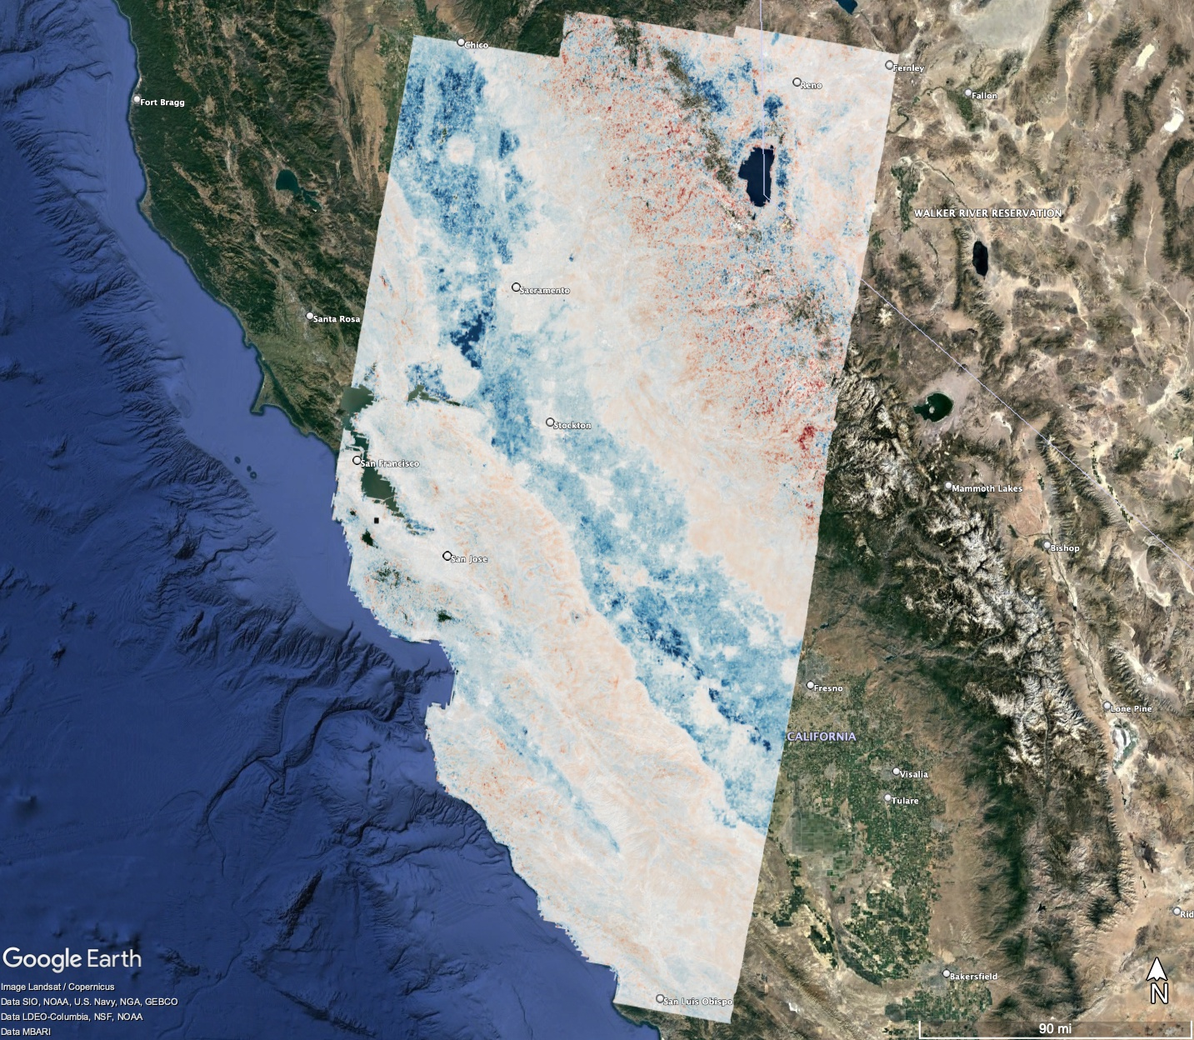
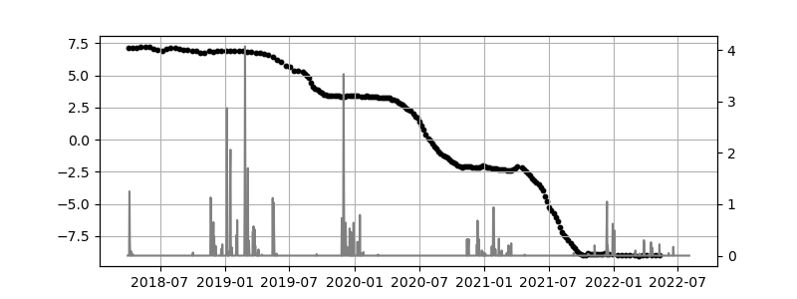
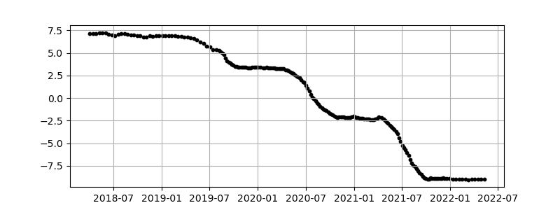
From soil moisture to closure phase bias – validation with data
Case II – Wet environment
closure phase bias, cm
precipitation, cm
250 km
Closure phase bias, cm/year
-3
0
3
* Processed Sentinel data courtesy of Zhen Liu, JPL, California Institute of Technology, USA

Slide 18
From closure phase bias to soil moisture – initial results
Case II – Wet environment
250 km
Closure phase bias, cm/year
-3
0
3
*Processed Sentinel data courtesy of Zhen Liu, JPL, California Institute of Technology, USA

Slide 19
Modeling soil moisture from closure phase bias - Summary
MODEL
OBSERVATION
A discrete soil moisture model
soil moisture -> closure phase bias
Soil moisture
Bias

Slide 20
Modeling soil moisture from closure phase bias – Summary
Advantages
Limitations
Linking soil moisture variation to bias accumulation is straightforward.
It offers potential to detect drought onset, produce high-resolution soil moisture maps and scale with global time-series products
Limited temporal resolution (limited by SAR acquisition intervals).
Inversion scheme has yet to be tested with extensive data.

Slide 21
From closure phase bias to soil moisture: bias gradient as a proxy
Bias gradient
SMAP soil moisture measurements

Slide 22
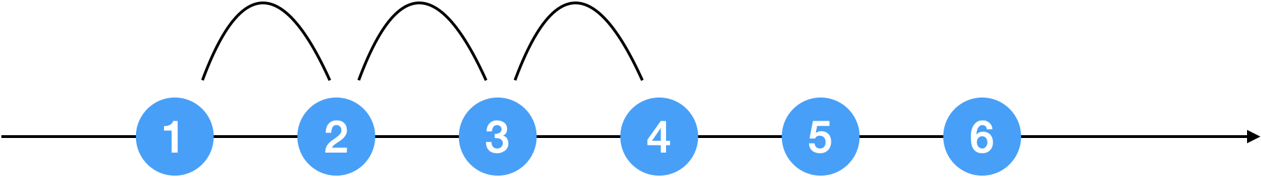
We use sequential closure phase to reconstruct the phase history of the bias-inducing process
$$Φ_{123}∝Δφ_{13}^{bias}$$
$$Φ_{234}∝Δφ_{24}^{bias}$$
$$Φ_{345}∝Δφ_{35}^{bias}$$
Sequential closure phase is only sensitive to bias-inducing processes.
Sequential closure phase is only sensitive to the phase difference between the first and the last date of the loop.
Notes:
Closure phase reflects the

Slide 23
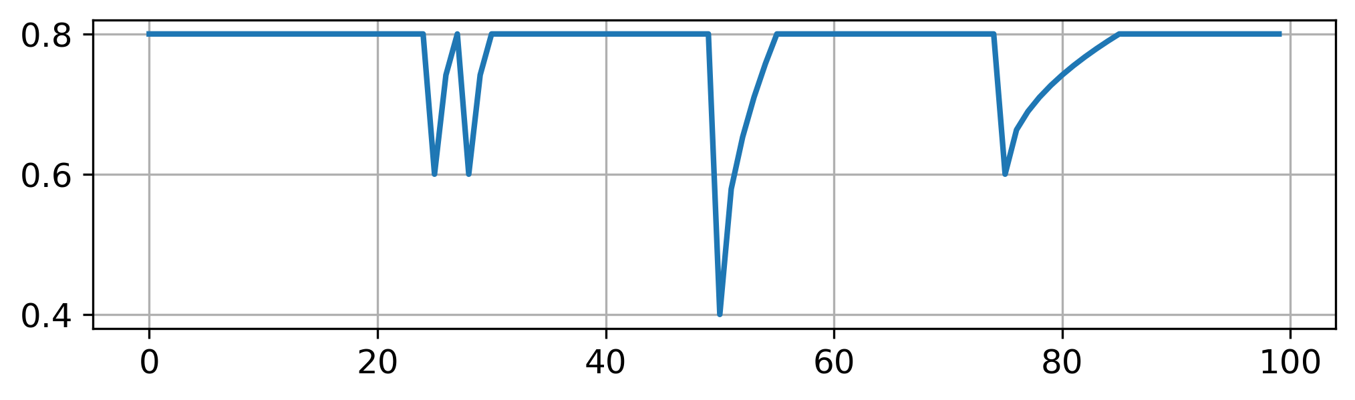
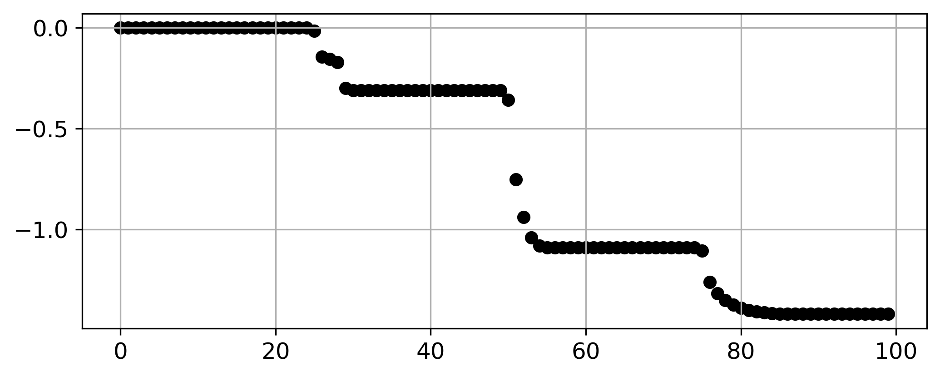
From soil moisture to closure phase bias – Numerical Simulation
Case II – Wet environment
Soil moisture
Key findings:
“Subsidence” in closure phase bias corresponds to soil moisture increase after irrigation.
Subsidence magnitude depends on soil moisture increase rate and variation
Slower increase and greater variation result in larger subsidence
Single or multiple disturbance in the same period not easy to be differentiated.
Closure phase bias, cm
acquisitions
Notes:
This is to show we have a forward model
Simulation results
Interpretation – why cumulative effects

Slide 24
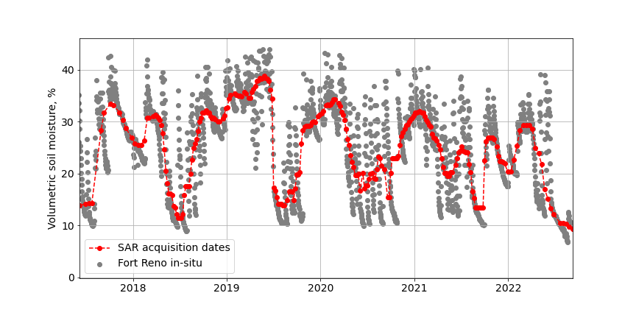
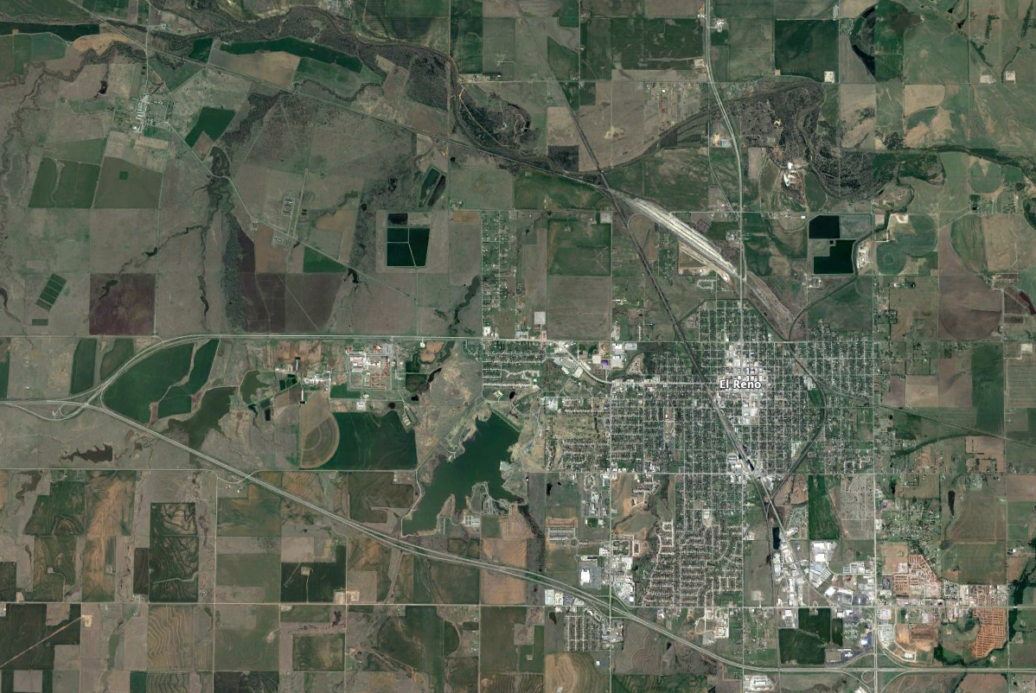
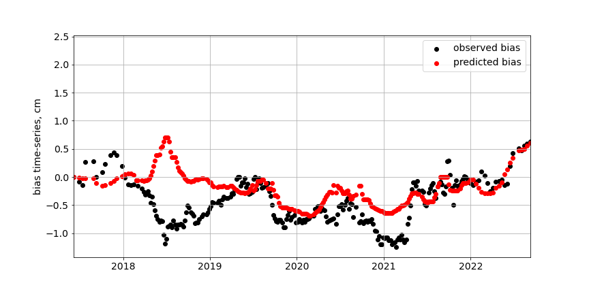
Future work – agricultural regions
SCAN network
Station: Fort Reno (id:2022)

